Slide 1
Blood Bank & Donor Management System
Pranav tatavarthy (ra2011031010011).
Prithvi SINGH KIRAR (RA2011031010023).
Arghya Pahar (RA2011031010029).

Slide 2
Abstract
The numbers of persons who are in need of blood are increasing in large number day by day. In order to help people who are in need of blood, the Online Blood Bank can be used effectively for getting the details of blood donors having the same blood group and within the same city. With the help of Online Blood Bank people who are having the thought of donating blood gets registered in Online Blood Bank giving his total details.
The site also helps people who are in need of blood by giving the details of the donors by searching, if at all there are no donors having the same group and within their own city they will be given the addresses with phone numbers of some contact persons in major cities who represent a club or an organization with free of cost.
The present project elucidates the following features.
Registering the Donors
Modification of Donor Information
Searching a Donor
Life Saving Contacts (in major cities)

Slide 3
Problem Statement
Problem
The major problem in old Blood banking systems was that they don’t follow the actual needs of users.
Traditional blood banking systems were developed by a 1 or 2 perspectives.
Tracking the database was complicated when the details are maintained manually.
There was a shortage and sometimes unavailability of rare blood groups due to fewer modules i.e. patient and donors.

Slide 4
Objective
The people who like to donate blood register on the site.
The person in need of blood searches for the people having the same blood group and within the city.
If he finds a donor in his city then he gets the total details of the donor, if he doesn’t find any donor then he is given the contact numbers and addresses of the Life Saving Contact Persons for major cities.
In this project we will use PHP and MySQL and it contains two modules i.e Admin and Donor.

Slide 5
Scope of Project
More enhanced search algorithms can be implemented
The Encryption standards can also be used to make the transactions more secure.
More modules can be introduced in the backend to have better relationships between tables
News panels can be added – (regarding Blood donation camps , Blood testing centres , etc.)

Slide 6
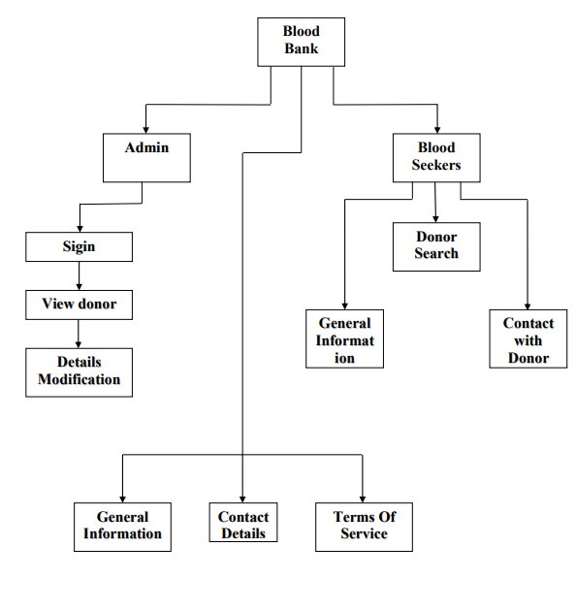
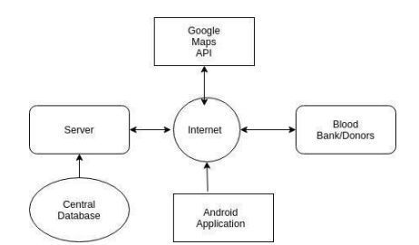
Architecture

Slide 7
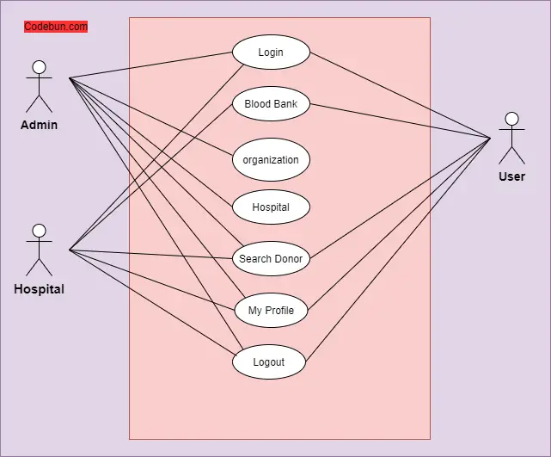
Use Case Diagrams

Slide 8
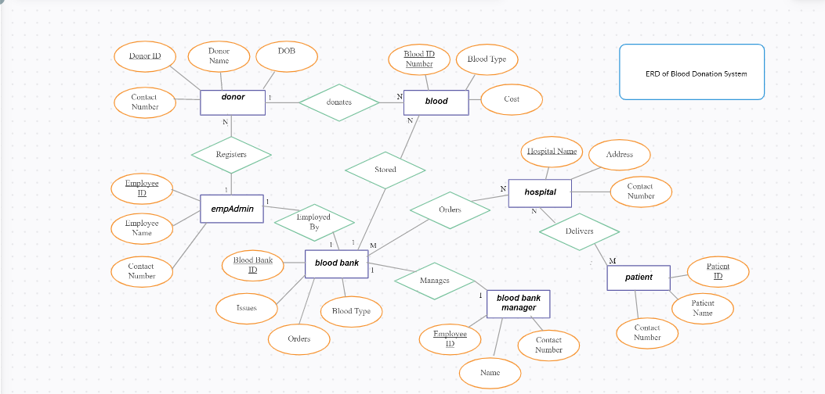
ER Diagram for Blood bank management system

Slide 9
Frontend UI and Software
Software Used ->
XML-
Used for creating the structure of the pages used in the software.
Inbuilt Kotlin Classes
Used for giving design To the UI required.
Provides responsiveness to the pages of the app.

Slide 10
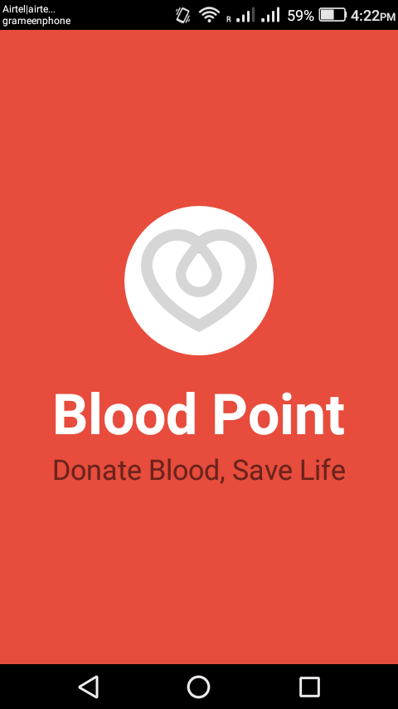
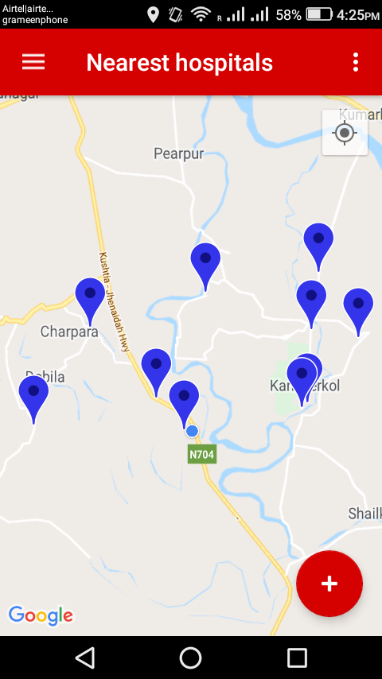
Screenshots Of UI

Slide 11
Backend TechStack
NodeJS
→ Javascript library used for designing routes for api calls.
Firebase
→ Used as Database Storage

Slide 12
References
https://dev.mysql.com/doc/
https://www.php.net/docs.php
www.w3school.com
www.eraktosh.in
http://nbtc.naco.gov.in/

Slide 13
Thank you.

